Slide 1


Assignment 1
Geolocation Analysis

Slide 2


Questions
The subscriber went to multiple locations during the day. Please identify possible POIs the subscriber visited and the corresponding dwell times.
How many journeys did the subscriber take throughout the day? Which are the origins/destinations of the journeys?
How would you derive the mode of transport for each journey based on time and geolocation information?

Slide 3
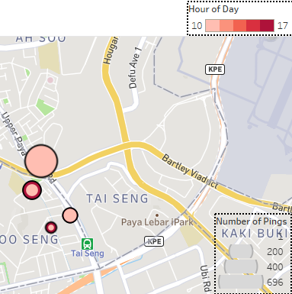
Q1 Identify possible POIs the subscriber visited and the corresponding dwell times.
1) Not exactly a “visit” but Joo Seng/Tai Seng is likely where individual is staying at i.e. Home
- Due to significant number of pings being captured both at the start and end of the day

Slide 4
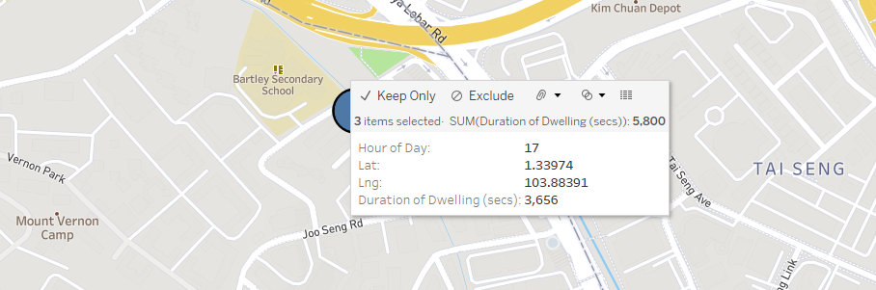
Q1 Identify possible POIs the subscriber visited and the corresponding dwell times.
1) Home
- Total Dwell Time: 5800 seconds

Slide 5
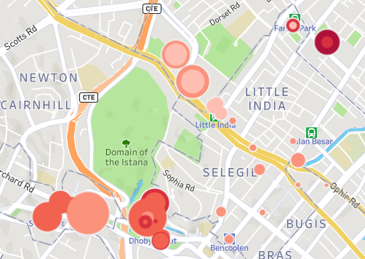
Q1 Identify possible POIs the subscriber visited and the corresponding dwell times.
Individual also made visits to the Little India area, as well as the Orchard area. Zooming into these areas, the POIs are:

Slide 6
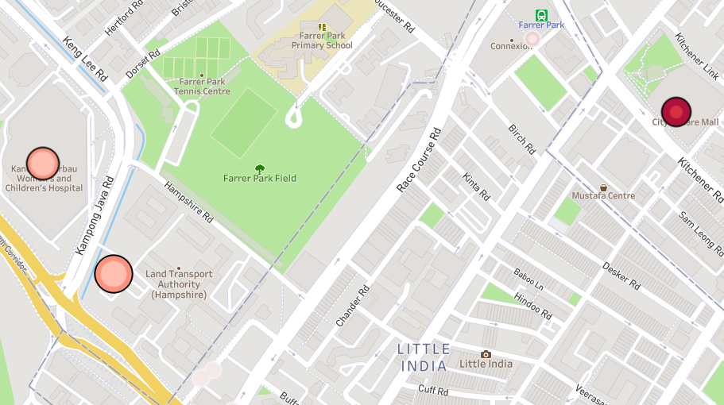
Q1 Identify possible POIs the subscriber visited and the corresponding dwell times.
2) Little India / Farrer Park area POIs
Land Transport Authority (Hampshire)
KK Women’s & Children’s Hospital
City Square Mall

Slide 7
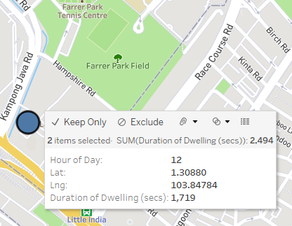
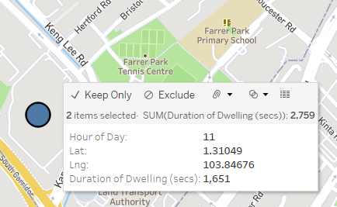
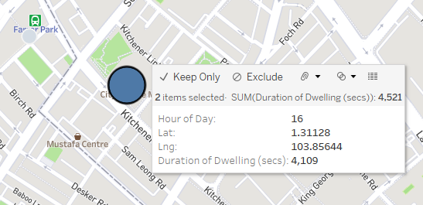
Q1 Identify possible POIs the subscriber visited and the corresponding dwell times.
2) Little India / Farrer Park area POIs
Land Transport Authority (Hampshire): 2759 seconds
KK Women’s & Children’s Hospital: 2494 seconds
City Square Mall: 4521 seconds

Slide 8
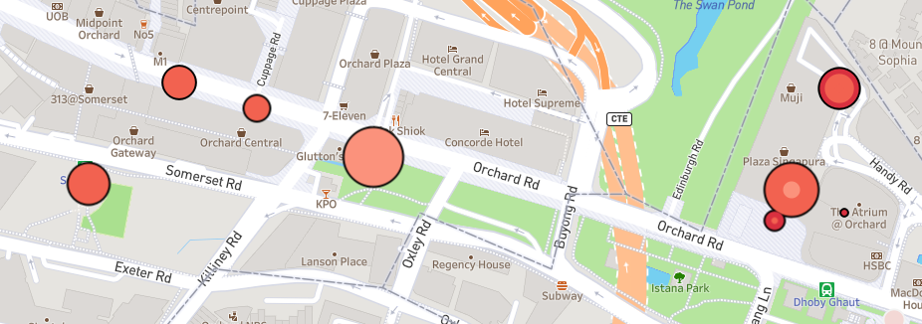
Q1 Identify possible POIs the subscriber visited and the corresponding dwell times.
3) Orchard area POIs
Plaza Singapura
Orchard Central / 313 @ Somerset / Orchard Gateway

Slide 9
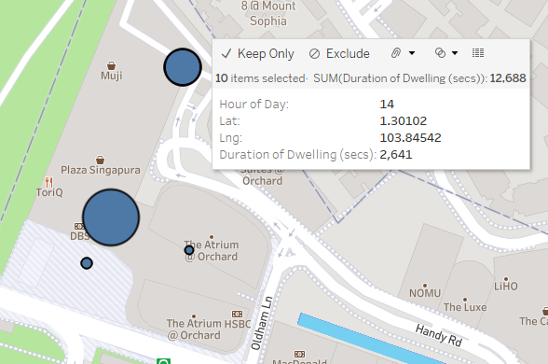
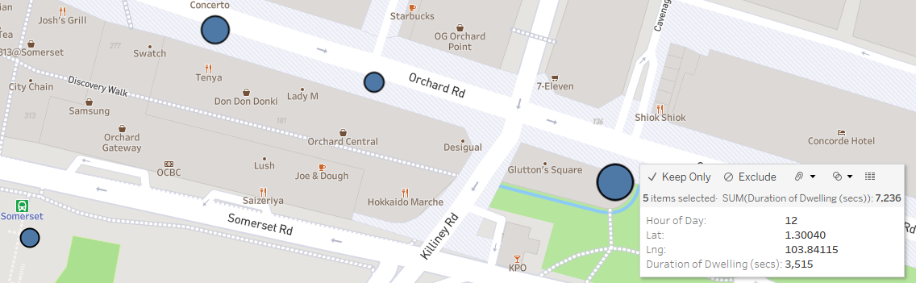
Q1 Identify possible POIs the subscriber visited and the corresponding dwell times.
3) Orchard area POIs
Plaza Singapura: 12688 seconds
Orchard Central / 313 @ Somerset / Orchard Gateway: 7236 seconds

Slide 10
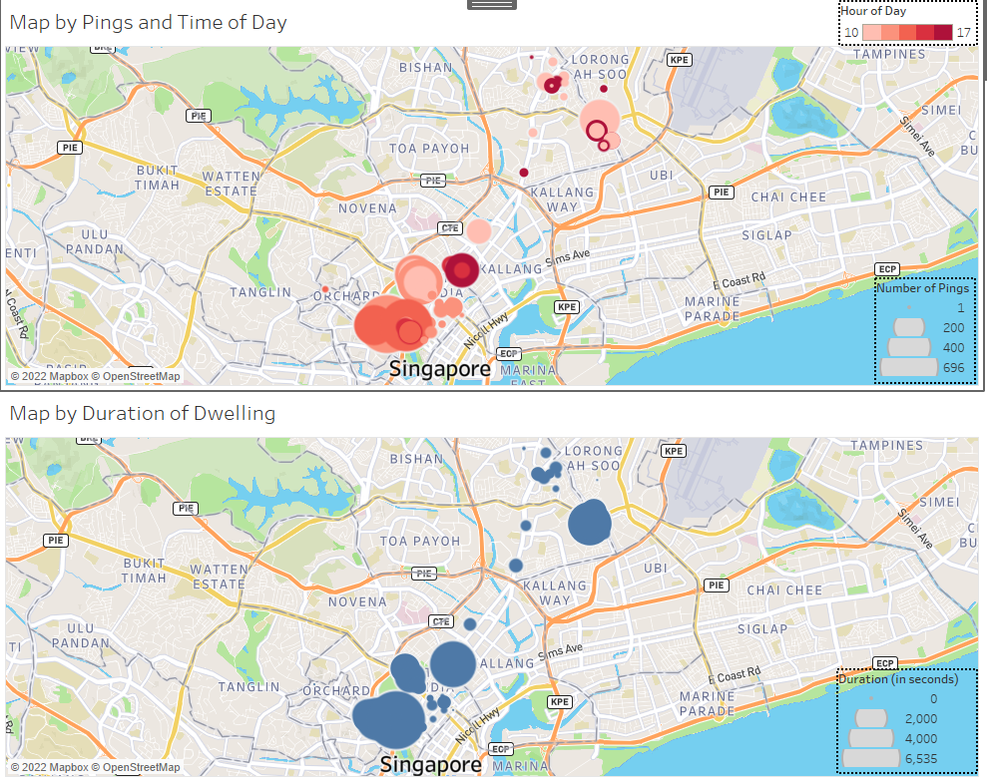
Q2 How many journeys did the subscriber take, and which are the origins/destinations?
Looking at the overview of map’s patterns, I would split the individual’s whole day movements into 4 journeys.

Slide 11
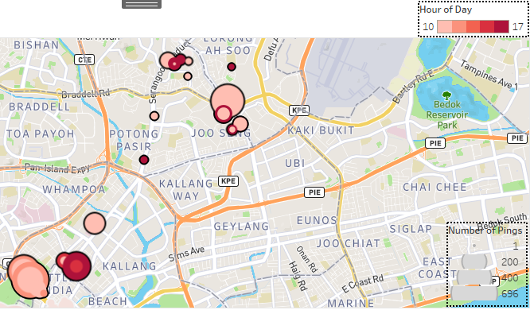
Q2 How many journeys did the subscriber take, and which are the origins/destinations?
Journey 1: Commuting to Little India area from Home
- Individual set off from home and arrived at Little India area for his/her first activity/errand, as evidenced from the slight change into darker shading at Little India (ignore the circles with the darkest shades for now)

Slide 12
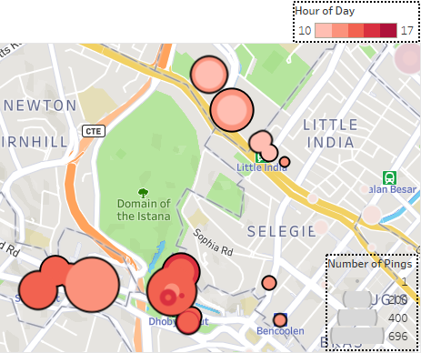
Q2 How many journeys did the subscriber take, and which are the origins/destinations?
Journey 2: Commuting from Little India area to Orchard area
- Individual then set off from Little India to Orchard and spends the bulk of his/her time there, once again evidenced from the gradual change into darker shades of circles in the Orchard area

Slide 13
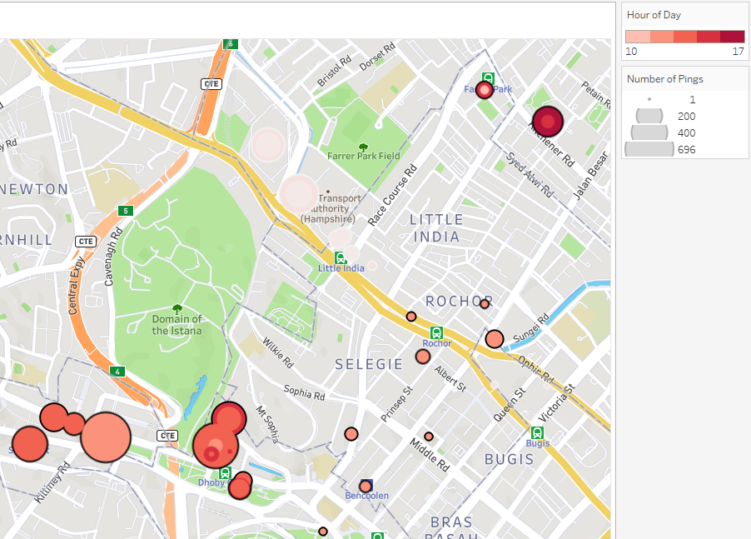
Q2 How many journeys did the subscriber take, and which are the origins/destinations?
Journey 3: Commuting from Orchard area to City Square
- Individual then set off from Orchard to City Square, with the circles at City Square / Farrer Park now turning into the darkest shades

Slide 14
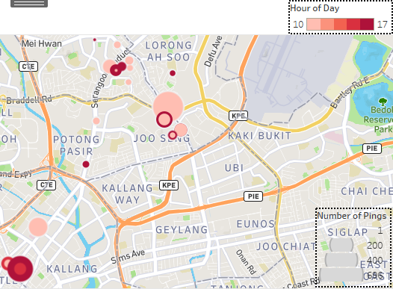
Q2 How many journeys did the subscriber take, and which are the origins/destinations?
Journey 4: Commuting City Square / Farrer Park back to Home
- Finally, individual heads home from City Square / Farrer Park, with the darkest shades of circles appearing as they did earlier in the day (an indication that individual’s residence is at those areas near Joo Seng)

Slide 15
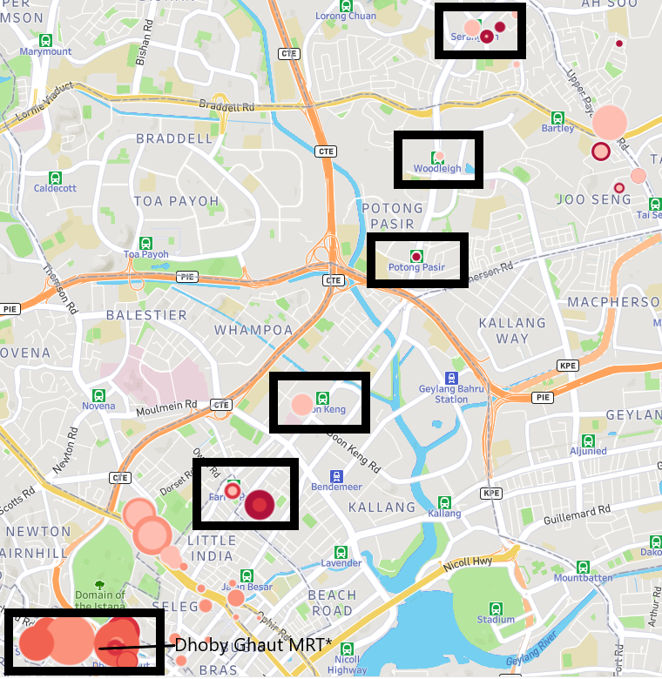
Q3 Derive the mode of transport for each journey based on time & geolocation information.
Visually, one can already tell that the individual took MRT for his/her journeys, as evidenced by the pings at the MRT stations (specifically the NEL stations)

Slide 16
Q3 Derive the mode of transport for each journey based on time & geolocation information.
For Journey 1 (left) – from home - and Journey 4 (right) – back to home - the individual likely took train as evidenced by the route following the NEL train route, with subsequent changing to Circle Line at Serangoon MRT station, onwards to Tai Seng MRT Station.
He/she could have taken a bus or cab, but on the basis of the movement pattern of the pings, MRT as his/her mode of transport is a better guess.

Slide 17
Q3 Derive the mode of transport for each journey based on time & geolocation information.
The same reasoning, as per previous slide, would apply to Journey 2 – from Little India area to Orchard area, via NEL (Little India MRT station pings and Dhoby Ghaut MRT station pings).

Slide 18
Q3 Derive the mode of transport for each journey based on time & geolocation information.
For Journey 3 – from Orchard area to City Square – it is not so obvious initially; the distribution of the pings amongst the Selegie/Rochor area indicate that the individual might have taken bus or cab to get to Farrer Park / City Square. But this does not account for the missing pings in the Little India district (presumably, the bus/car should pass through that area and show some pings).
More importantly, there are some circles of shades, appearing at Dhoby Ghaut, that are lighter than those in the Selegie/Rochor, indicating that the individual likely instead took the train from Dhoby Ghaut MRT Station to Farrer Park MRT station.

